Slide 1


Slide 2
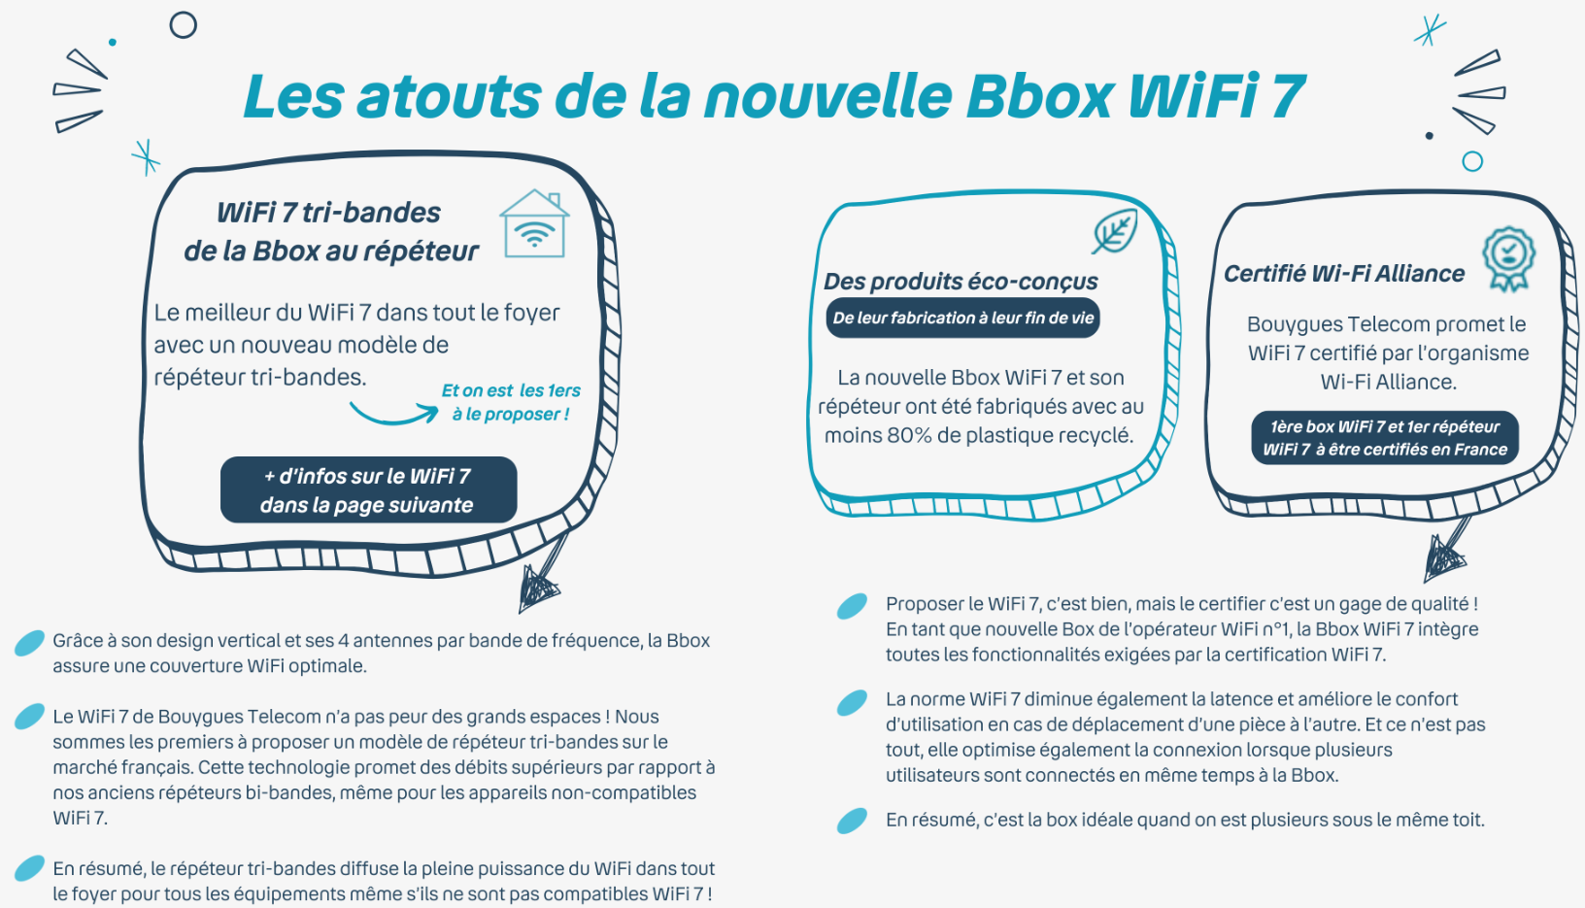

Slide 3
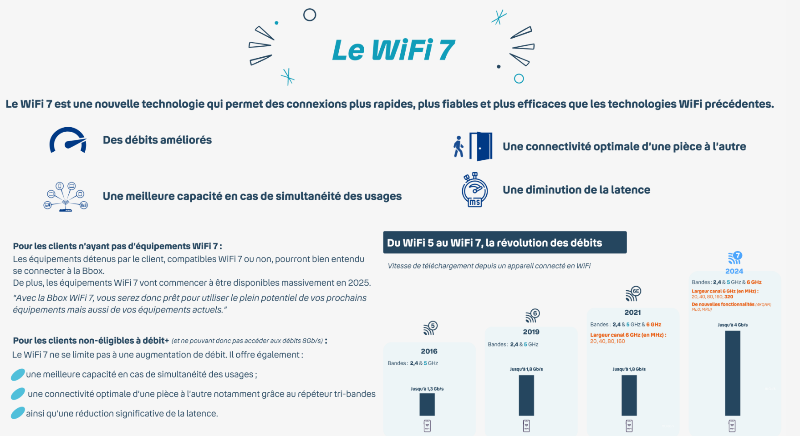

Slide 4


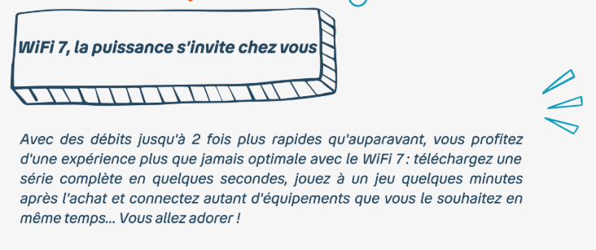

Avantages Bbox ULTYM Wi-Fi 7

